Slide 1


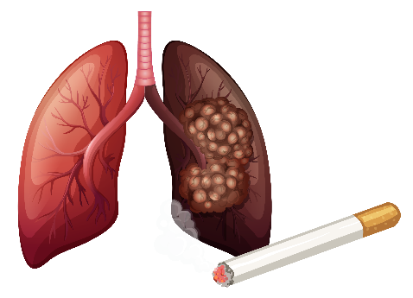




Data Analysis
Futurion
UPSKILLING INDIA
Portfolio Project Challenge
Lung Cancer Data Analysis
Individual Contributor
Suman Sadhukhan
Submission Date - 21/02/2025
Tools Used
01

Slide 2
🧐 Problem Statement:
Lung cancer remains a leading cause of cancer-related deaths worldwide, with smoking and environmental factors playing a crucial role in its development. Early detection and risk assessment can significantly improve survival rates. This project aims to analyse a real-world lung cancer dataset to uncover key patterns, evaluate risk factors, and provide insights that can aid in early diagnosis and preventive measures.
🎯 Project Objectives:
✅ Identify High-Risk Groups: Analyse demographic trends (age, gender, location) to determine populations most affected. ✅ Assess Key Risk Factors: Evaluate the impact of smoking, passive smoking, and family history on lung cancer prevalence. ✅ Explore Environmental Influences: Investigate air pollution exposure and its correlation with lung cancer cases. ✅ Analyse Early Detection & Survival Rates: Examine how early diagnosis impacts survival outcomes. ✅ Create Interactive Visualizations: Develop dynamic Power BI dashboards to present findings effectively. ✅ Provide Data-Driven Recommendations: Offer insights that healthcare professionals and policymakers can use for preventive strategies.
📊 Tech Stack: SQL, Power BI, Figma, Excel 💡 Goal: Deliver actionable insights that support lung cancer research and awareness efforts.
🚀 Let’s dive deep into the data and turn insights into impact!
Futurion
UPSKILLING INDIA
02

Slide 3
Dataset Overview
Futurion
📂 Dataset Summary:
The dataset used in this project contains crucial health-related attributes to analyze lung cancer risk factors. It includes details on smoking habits, passive smoking exposure, family history, and lung cancer diagnosis.
🔍 Key Dataset Features:
✅ Total Records: 2206332 ✅ Total Columns: 24
✅ Data Source: It's publicly available
Columns names - ID, Country, Population_Size, Age, Gender, Smoker, Years_of_Smoking, Cigarettes_per_Day, Passive_Smoker, Family_History, Lung_Cancer_Diagnosis, Cancer_Stage, Survival_Years, Adenocarcinoma_Type, Air_Pollution_Exposure, Occupational_Exposure, Indoor_Pollution, Healthcare_Access, Early_Detection, Treatment_Type, Developed_or_Developing, Annual_Lung_Cancer_Deaths, Lung_Cancer_Prevalence_Rate, Mortality_Rate.
UPSKILLING INDIA
03
03
03

Slide 4
Futurion
Data Cleaning and Pre-processing Steps :
The dataset was mostly clean and well-structured, requiring only minor adjustments. Cleaning was efficient, with no significant time needed for pre-processing.
✅ Handled Missing Values:
Identified and replaced missing values in critical columns to ensure data consistency.
Converted "None" values in the Treatment Type column to "No Treatment" for better interpretation.
✅ Validated Data Integrity:
Checked for duplicate records and removed inconsistencies.
Ensured numerical fields had valid entries
✅ Created Calculated Metrics for Analysis:
Lung Cancer Risk Score: Developed a calculated metric based on smoking habits, passive smoking exposure, and family history to assess individual risk levels.
Smoking Impact Bin: Categorized individuals into different risk levels based on years of smoking and cigarettes per day for better segmentation in analysis.
✅ Standardized Data for Analysis:
Reformatted categorical variables for better readability and visualization in Power BI.
Ensured proper data types for SQL queries and Power BI dashboards.
This cleaned dataset served as the foundation for further SQL analysis and Power BI visualization, providing meaningful insights into lung cancer risk factors. 🚀
UPSKILLING INDIA
04

Slide 5

Futurion
UPSKILLING INDIA
SQL Queries & Solutions
3
05

Slide 6
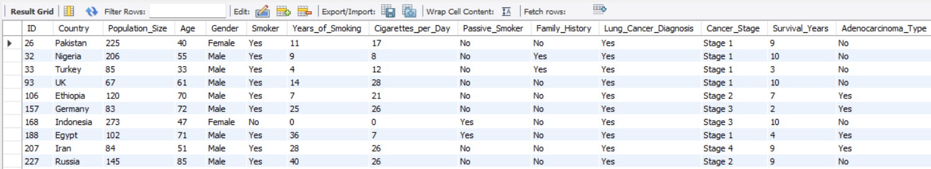
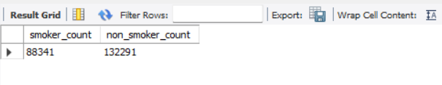
Basic Level
Q1. Retrieve all records for individuals diagnosed with lung cancer.
SELECT * from lung_cancer_data
where Lung_Cancer_Diagnosis = 'Yes' ;
Futurion
UPSKILLING INDIA
Q2. Count the number of smokers and non-smokers.
SELECT (select count(*) from lung_cancer_data where Smoker = 'Yes') as smoker_count,
(select count(*) from lung_cancer_data where Smoker = 'No') as non_smoker_count ;
07
06

Slide 7

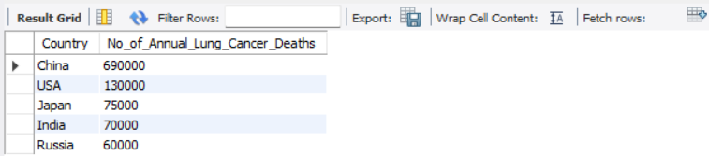
Q3. List all unique cancer stages present in the dataset.
SELECT distinct cancer_stage from lung_cancer_data
where cancer_stage <> "None";
Futurion
UPSKILLING INDIA
Q4. Retrieve the average number of cigarettes smoked per day by smokers.
SELECT ROUND(avg(Cigarettes_per_Day),0) average_cigarettes_count from lung_cancer_data ;
Q5. Count the number of people exposed to high air pollution.
SELECT count(Air_Pollution_Exposure) from lung_cancer_data where Air_Pollution_Exposure = 'High' ;
07
07

Slide 8
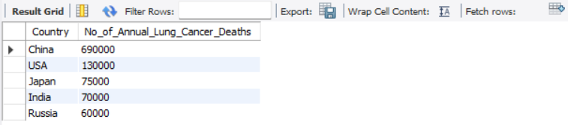
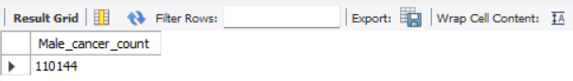
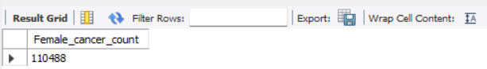
Q6. Find the top 5 countries with the highest lung cancer deaths.
select Country , max(Annual_Lung_Cancer_Deaths) as No_of_Annual_Lung_Cancer_Deaths from lung_cancer_data group by Country order by max(Annual_Lung_Cancer_Deaths) desc limit 5 ;
Futurion
UPSKILLING INDIA
Q7. Count the number of people diagnosed with lung cancer by gender.
select count(*) as Male_cancer_count from lung_cancer_data where gender = 'Male';
select count(*) as Female_cancer_count from lung_cancer_data where gender = 'Female' ;
07
08

Slide 9
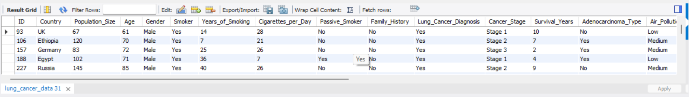
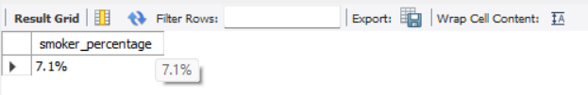
Futurion
Q8. Retrieve records of individuals older than 60 who are diagnosed with lung cancer.
select * from lung_cancer_data where age > 60 and Lung_Cancer_Diagnosis = 'Yes';
UPSKILLING INDIA
Intermediate Level ->
Q1. Find the percentage of smokers who developed lung cancer.
SELECT concat(round(100*(select count(*) from lung_cancer_data where Lung_Cancer_Diagnosis = 'Yes' and smoker= 'Yes')/count(*),1),"%") as smoker_percentage from lung_cancer_data where smoker= 'Yes';
07
09

Slide 10
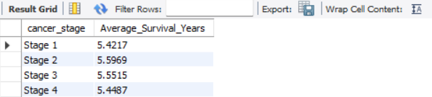
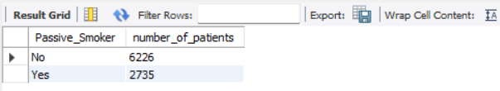
Q2.Calculate the average survival years based on cancer stages.
select cancer_stage, avg(Survival_Years) as Average_Survival_Years from lung_cancer_data
where Cancer_Stage <> "None" group by cancer_stage;
Futurion
UPSKILLING INDIA
Q3. Count the number of lung cancer patients based on passive smoking.
select Passive_Smoker, count(*) as number_of_patients
from lung_cancer_data
where Lung_Cancer_Diagnosis = 'Yes' group by Passive_Smoker;
07
10

Slide 11

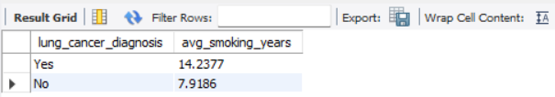
Q4. Find the country with the highest lung cancer prevalence rate.
select Country Country_with_highest_Lung_Cancer_Prevalence_Rate
from lung_cancer_data group by Country
order by max(Lung_Cancer_Prevalence_Rate) desc limit 1;
Futurion
UPSKILLING INDIA
Q5. Identify the smoking years' impact on lung cancer.
SELECT lung_cancer_diagnosis, AVG(Years_of_Smoking) AS avg_smoking_years FROM lung_cancer_data GROUP BY lung_cancer_diagnosis;
07
11

Slide 12
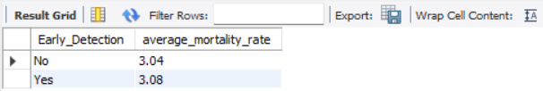

Q6. Determine the mortality rate for patients with and without early detection.
SELECT Early_Detection, round(avg(Mortality_Rate),2) average_mortality_rate from lung_cancer_data group by Early_Detection ;
Futurion
UPSKILLING INDIA
Q7. Group the lung cancer prevalence rate by developed vs. developing countries.
SELECT Developed_or_Developing, round(avg(Lung_Cancer_Prevalence_Rate),2) Lung_Cancer_Prevalence_Rate from lung_cancer_data group by Developed_or_Developing ;
07
12

Slide 13
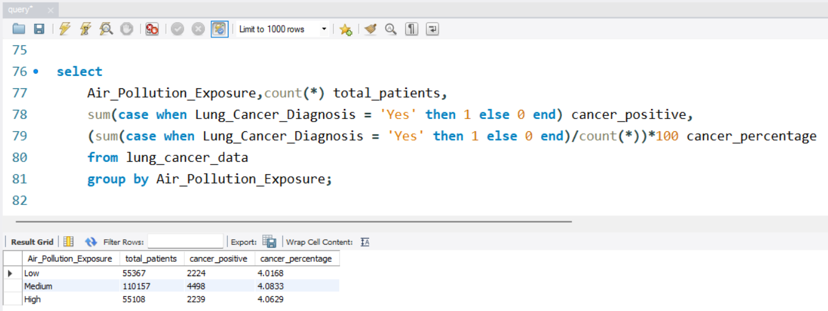
Advanced Level ->
Q1. Identify the correlation between lung cancer prevalence and air pollution levels.
Futurion
UPSKILLING INDIA
07
13

Slide 14
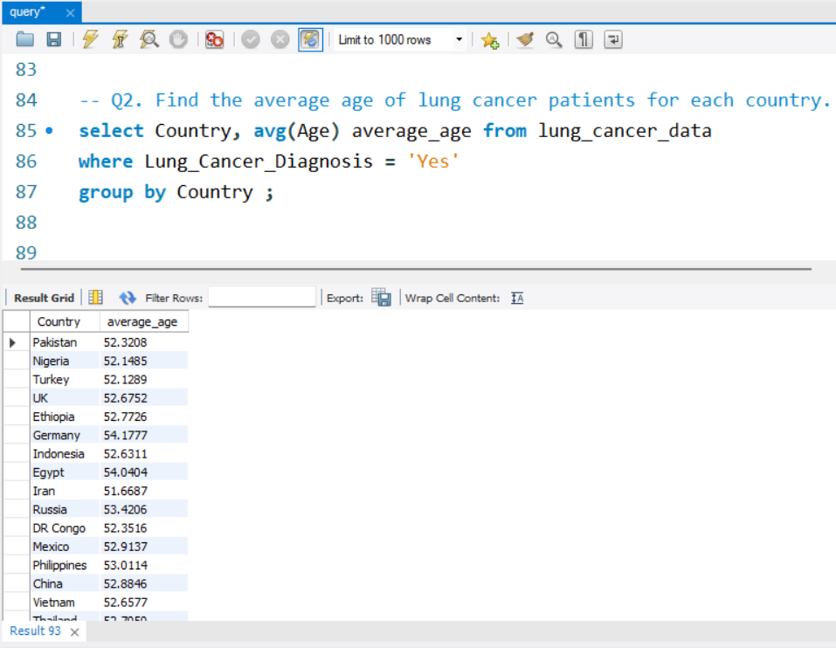
Q2. Find the average age of lung cancer patients for each country.
Futurion
UPSKILLING INDIA
07
14

Slide 15
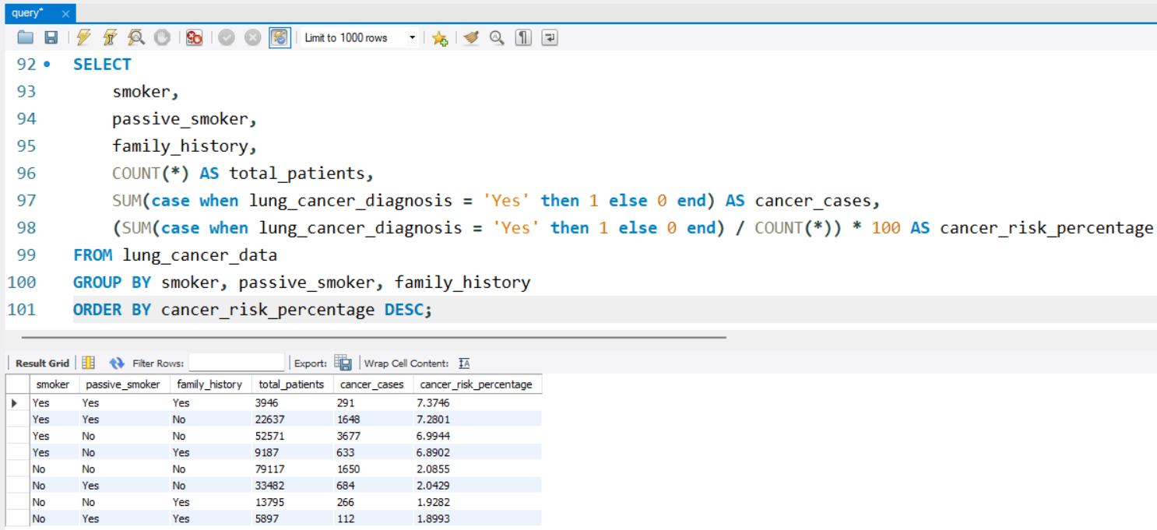
Futurion
UPSKILLING INDIA
Q3. Calculate the risk factor of lung cancer by smoker status, passive smoking, and family history.
07
15

Slide 16
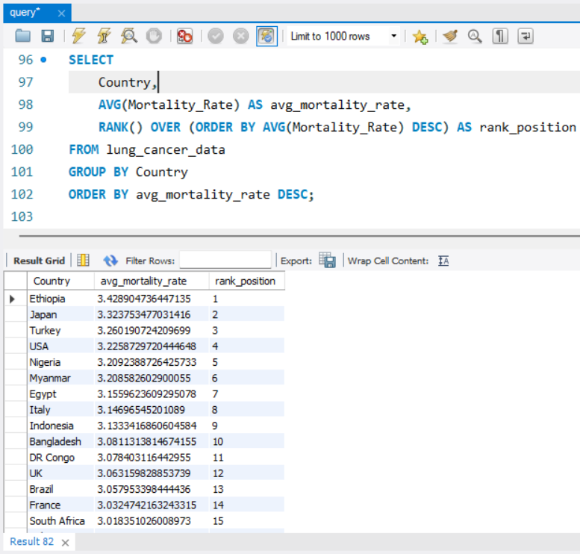
Q4. Rank countries based on their mortality rate.
07
16

Slide 17
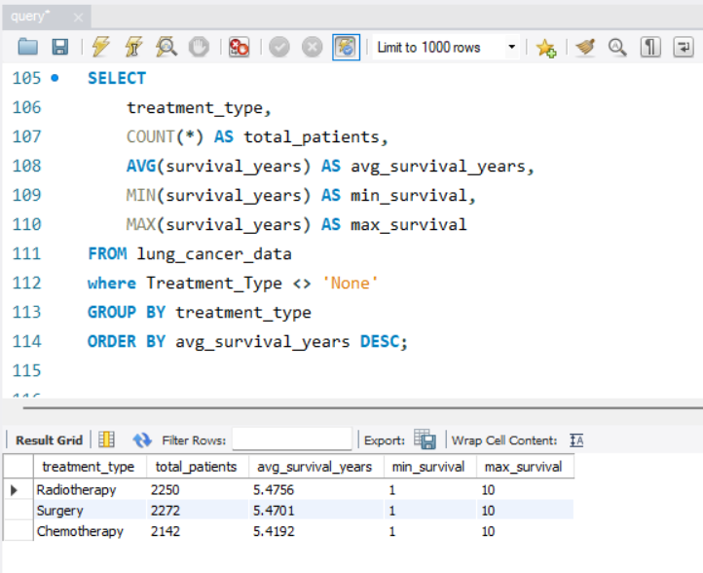
Q5. Determine if treatment type has a significant impact on survival years.
07
17

Slide 18
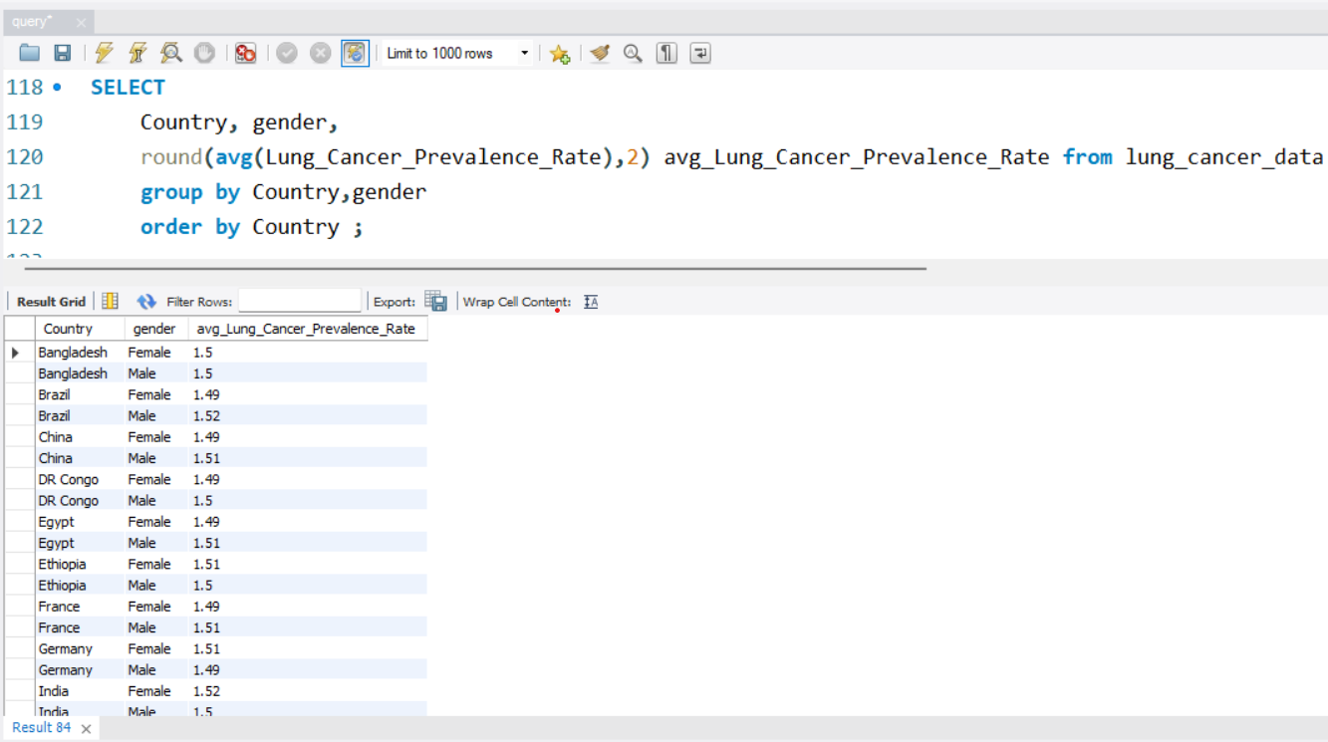
Q6. Compare lung cancer prevalence in men vs. women across countries.
07
18

Slide 19
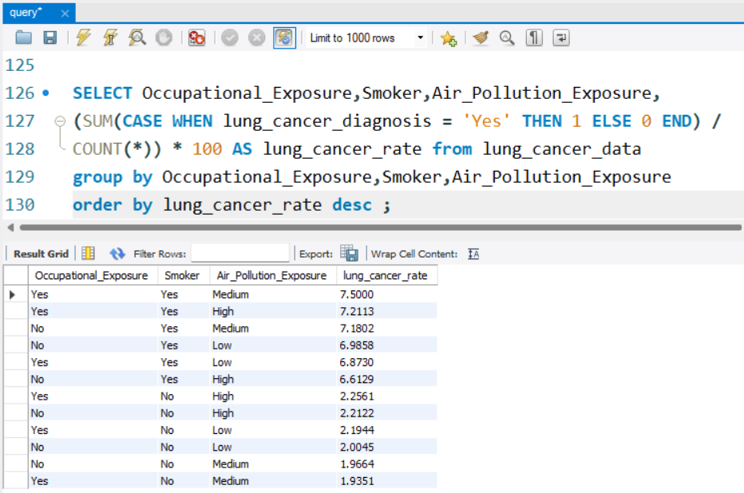
Q7. Find how occupational exposure, smoking, and air pollution collectively impact lung cancer rates.
07
19

Slide 20
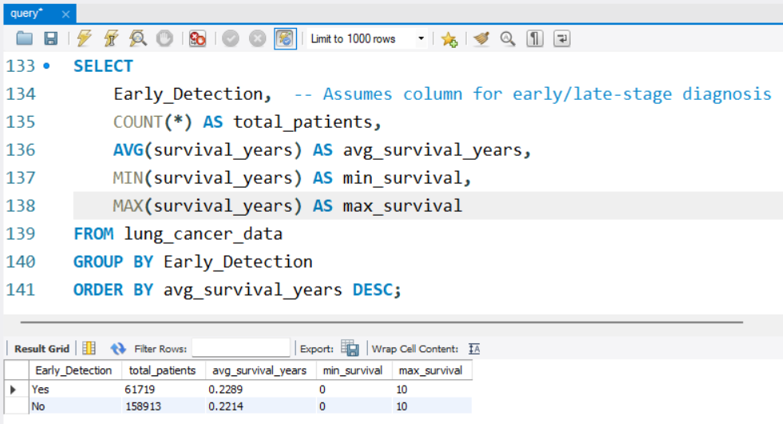
Q8. Analyse the impact of early detection on survival years.
07
20

Slide 21
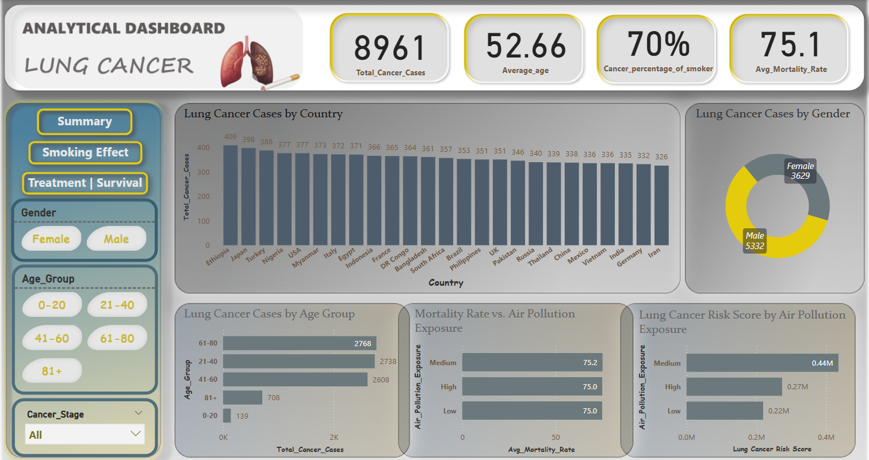
Futurion
UPSKILLING INDIA
21
07

Slide 22
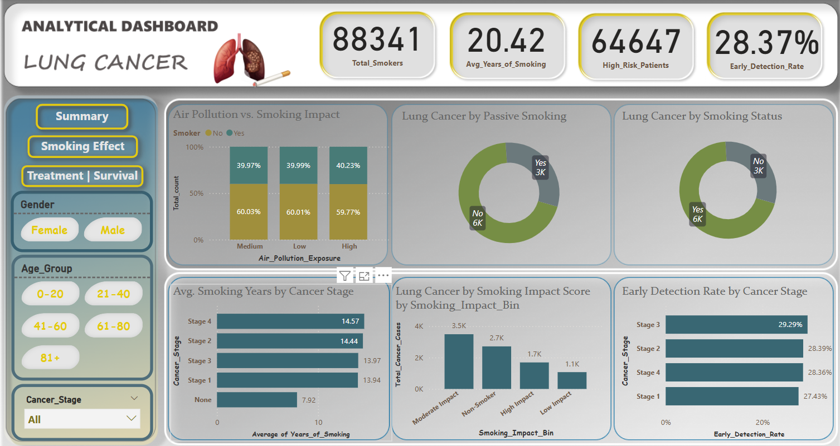
Futurion
UPSKILLING INDIA
22
07

Slide 23
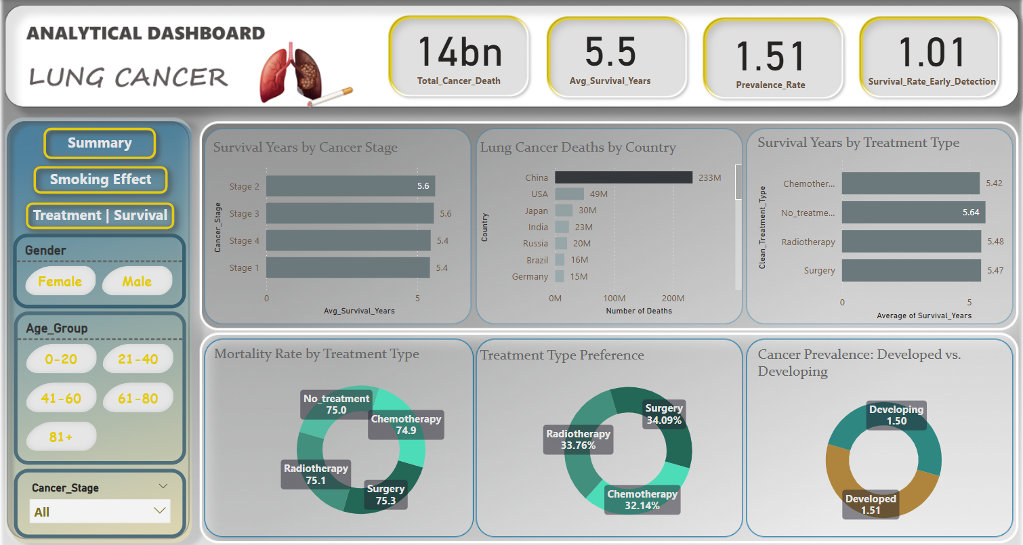
Futurion
UPSKILLING INDIA
23
07

Slide 24


Futurion
UPSKILLING INDIA
Insights:
Lung Cancer Prevalence & Country-wise Deaths
China has the highest lung cancer prevalence rate.
Developed and developing countries show a similar prevalence rate (~1.5).
Highest lung cancer deaths: China (233M), followed by USA, Japan, India, and Russia.
Most lung cancer cases observed in Ethiopia (409), Japan (398), and Turkey (388).
Smoking & Lung Cancer Correlation
Out of ~9K patients, 6K are smokers and 3K are non-smokers, indicating a strong correlation.
7.1% of smokers have developed lung cancer.
The average smoking duration for lung cancer patients is 14 years.
Longer smoking history is linked to advanced cancer stages.
Age-wise Analysis
Most affected age groups:
61-80 years: 2,768 cases
21-40 years: 2,738 cases
41-60 years: 2,608 cases
Treatment & Mortality Analysis
Surgery has the highest mortality rate (75.3%), while chemotherapy has the lowest (74.9%).
Most preferred treatment: Surgery (34.09%), followed by radiotherapy and chemotherapy.
Gender-based Analysis & Survival Rate
Males are more affected by lung cancer (5,332 cases) than females (3,629 cases).
No significant difference in survival years between males and females.
Average survival time for lung cancer patients is 5.5 years.
24

Slide 25
Futurion
UPSKILLING INDIA
Strategic Recommendations for Lung Cancer Prevention & Management
1. Policy & Environmental Actions -
Strengthen smoking laws, air quality policies, and workplace health standards.
Reduce occupational and environmental risk factors through stricter regulations.
2. Prevention & Awareness -
Expand smoking cessation programs, especially for men.
Raise awareness about passive smoking risks, particularly for women.
Launch education campaigns on smoking and indoor pollution hazards.
3. Early Detection & Screening -
Invest in advanced early detection methods for high-risk groups.
Strengthen screening programs to improve survival rates.
4. Healthcare & Treatment -
Enhance post-treatment rehabilitation and personalized care plans.
Improve access to surgery, chemotherapy, and radiotherapy.
5. Research & Data-Driven Insights -
Study regional disparities and survival factors.
Explore lifestyle risks beyond smoking for better prevention.
25

